Slide 1


Options Pricing Using Machine Learning
Aditya Dhanotia - 9427142877 Jash Patani - 4558521556
Soumya Nambi Ganesh - 6494399900
Shubhangi Sharma - 5801432713 Shantanu Trivikram - 1214307012
Tanvi Vijay - 3001184782

Slide 2
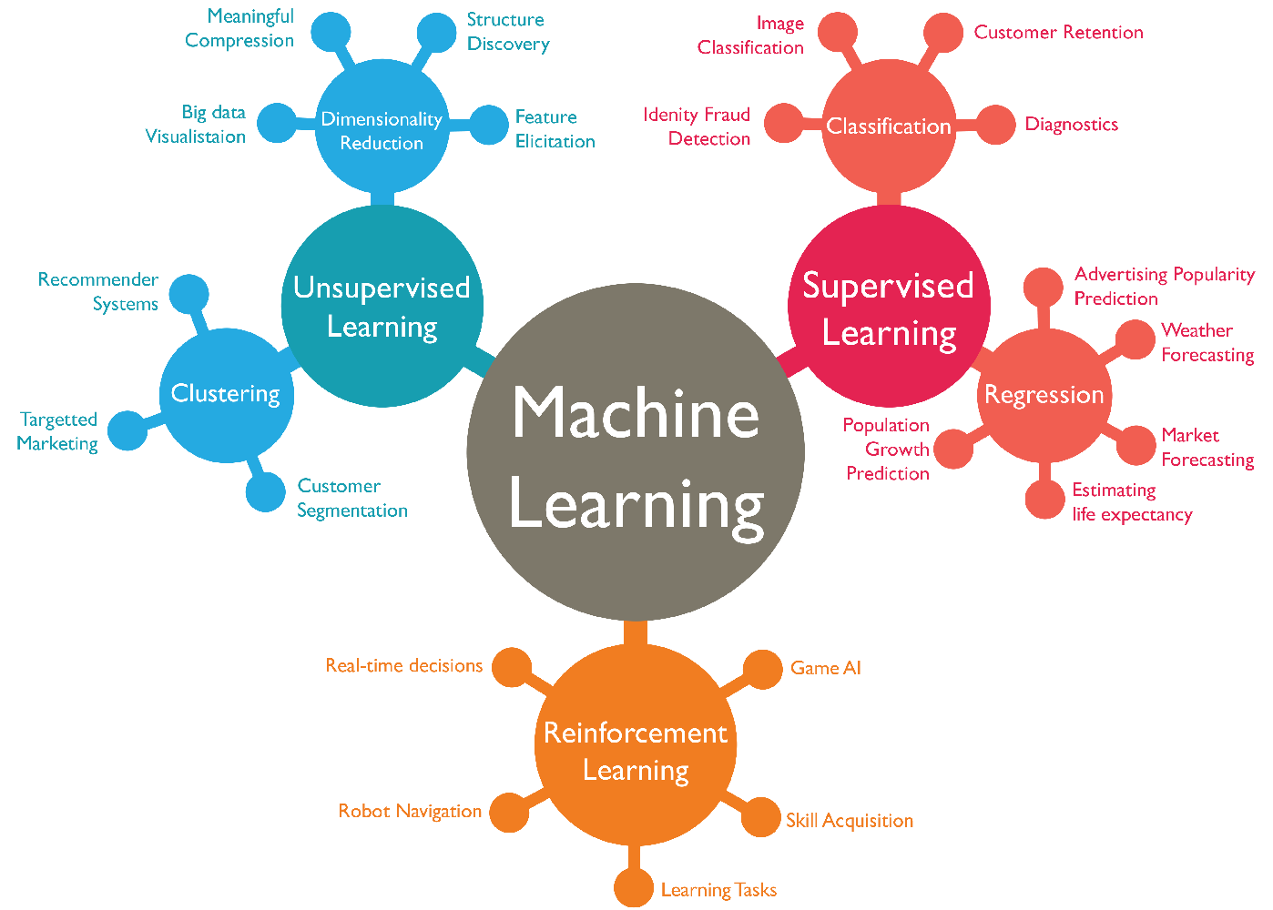
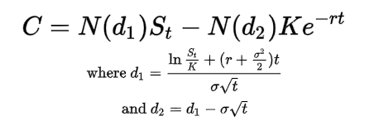
Advantages of Machine Learning
Accuracy
Efficiency
Flexibility
Reduced Bias
Adaptability

Slide 3
Problem Statement
To build statistical/ML models to value European call options on the S&P 500 without using the Black-Scholes formula
Cleaning data set and using it to build regression and classification models to predict the option value and the Black-Scholes(BS) formula value, respectively
Find the model which gives the highest accuracy score and use it for test data
Goal
Goal is to select the most accurate approach and use it to make predictions for option value and the Black-Scholes formula value on the test data set

Slide 4
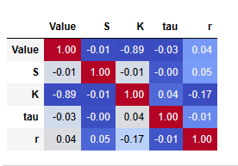
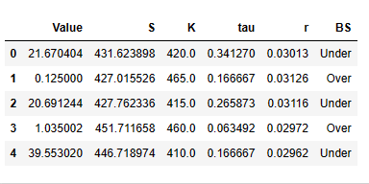
Understanding the data
1,680 separate options with 6 columns
• S: Current asset value
• K: Strike price of option
• r: Annual interest rate
• tau: Time to maturity (in years)
Predictor Variables
Response Variables
Value (C): Current option value
BS: Over, if the prediction using Black-Scholes over-estimated the option value; otherwise, we associate that option with Under.
Correlation Matrix
Sample Data Values

Slide 5
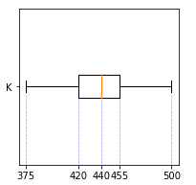
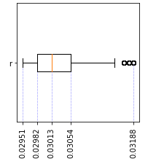
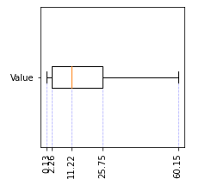
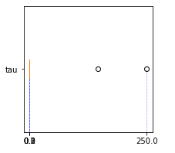
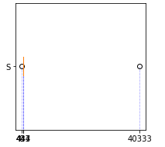
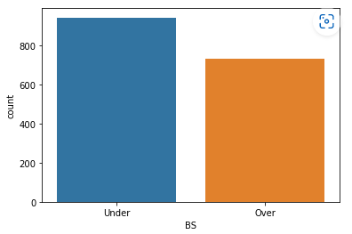
Predictor Variables
Response Variables
Notes:
EDA of the variables
K - strike price S current asset value 442
Under 946
Over 734
tau- median .20

Slide 6
Cleaning - Outlier Detection
1 2
3
Null values
Outliers – Std Deviation
Outliers – Definition
Filtering out rows where more than one feature is null/value is null
Detecting outliers which lie more than 3 standard deviations away from the mean
Detecting outliers based on the definition of the different features

Slide 7
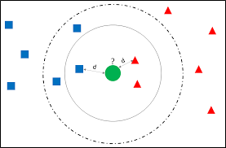
Imputation logic – KNN Imputer
Impute null to outlier
Find nearest 5 neighbours based on other features
Impute the mean of those 5 neighbours

Slide 8

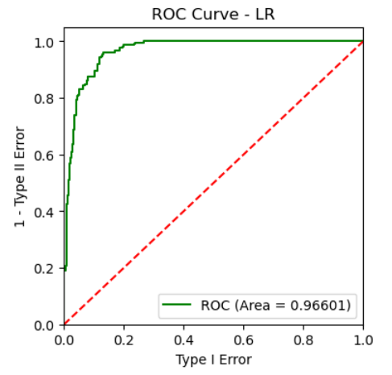
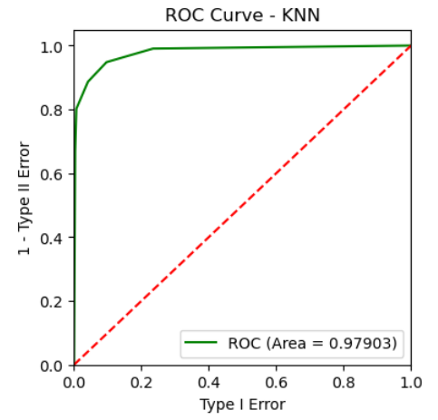
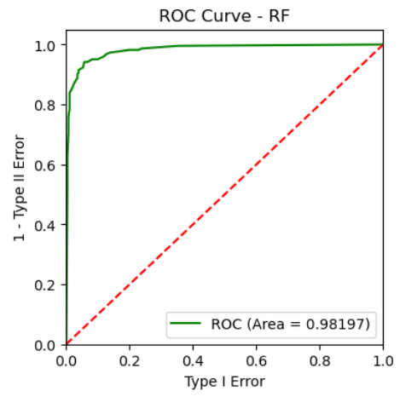
Comparison of Classification Models
LR Classifier
KNN Classifier
RF Classifier
AUC : 0.966 Accuracy: 0.90
AUC : 0.97 Accuracy: 0.92
AUC : 0.98 Accuracy: 0.94
Notes:
We have used three classifiers for our options dataset
LR, KNN, RF

Slide 9
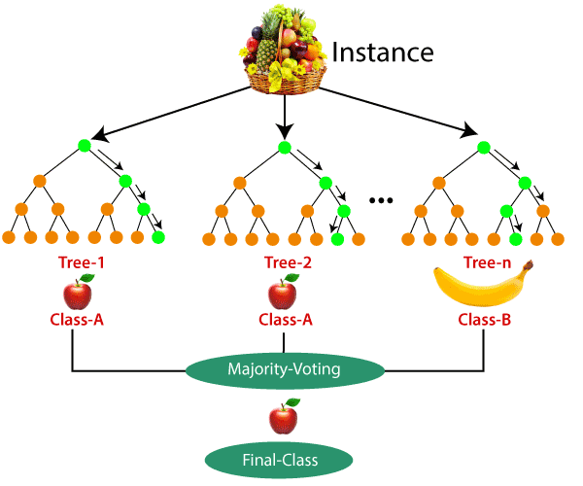
Random Forest Classification (Best Model)
Supervised Learning Algorithm
Collection of Decision Trees
Based on Ensemble Learning Methodology (Uses Bagging)
Each Decision Tree Generates an Output
Final Classification output depends on majority voting
Notes:
Random forest is a type of supervised learning algorithm. It is an ensemble method that combines multiple decision trees to create a more accurate and robust model. Ensemble Learning is nothing but usage of many combined models instead of one. In this case, many decision Trees.
Random Forest is based on Bagging Concept where everytime while creating a tree, it creates a different training subset from the sample training data with replacement and final output is based on majority Voting

Slide 10
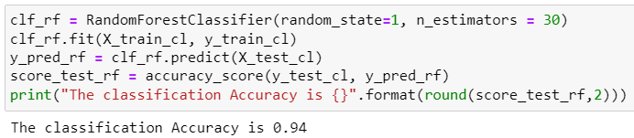
Random Forest Classification (Best Model)
Code Snippet
Number of Decision Trees used in the model = 30
 | Predicted Under | Predicted Over
Actual Under | 270 (TN) | 11 (FN)
Actual Over | 19 (FP) | 202 (TP)
Confusion Matrix:

Slide 11
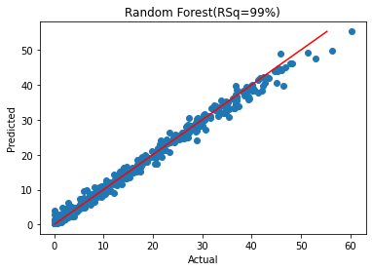
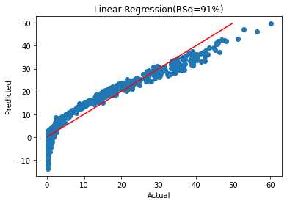
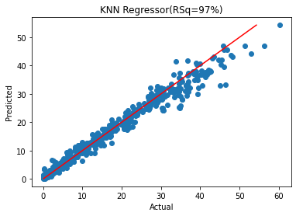
Comparison of Regression Models
Notes:
We explored 3 regressors and saw excellent results for 3 models - KNN, Linear Regression and RF.
RF gave us the

Slide 12

Model Hyperparameters
number of decision trees to be included
number of features at each split at each node
maximum depth of the decision trees
reproducibility and debugging purposes
Notes:
Started on a basic RF model and tuned our hyperparameters based on the features and data points to create a good model, but not too good a model as we of course didn't want to achieve overfitting.
Based on the no of features, data points and to avoid overfitting, so the model can be more generic, the following hyper parameters were chosen.
Besides giving a high accuracy ad the fact that RF is an ensemble approach (as Jash mentioned earlier) also takes care of feature selection at every split, something that the other 2 do not do.

Slide 13
Conclusion
(1) in both prediction problems, would you argue if prediction accuracy or interpretation is more important?
Tradeoff b/w accuracy and interpretability. As accuracy increases – complexity increases at the cost of interpretability
We focused on predictive performance top achieve the choosing the model with highest accuracy.
(2) why do you think machine learning models might outperform Black-Scholes in terms of predicting option values?
Black scholes assumes log-normal dist & constant volatility. ML models can help capture the volatility in stock prices that change over time.
(3) can you argue from a business perspective that all four predictor variables should be included in your prediction (i.e., no variable selection is necessary)?
All 4 variables fall into the calculation of option’s value. But asset’s value & strike price relate to intrinsic value of option. Time to maturity also relate to intrinsic and time value of option
Interest rate relates to rate of holding the asset & opportunity cost of investing which hold less importance than the other 3 variables
(4) Are you comfortable about directly using your trained model to predict option values for Tesla stocks?
Why?
Asymmetric variables - growth rate, cash flow projection, tweets by elon musk
Notes:
Trade off between - interpretability and accuracy
We concluded from our data exploration and analysis that the features in the dataset are strong predictors of the intrinsic value of the option which represents interpretability
Hence, our focus was more on accuracy, we worked on our models to gain maximum accuracy

Slide 14
Do we need all 4 variables?

